Slide 1
COMP3028 Software Architecture

Slide 2
Designing an Architecture

Slide 3
Design Strategy
Decomposition
Designing to Architecturally Significant Requirements
Generate and Test

Slide 4
Decomposition
Architecture determines quality attributes
Important quality attributes are characteristics of the whole system.
Design begins with the whole system
The whole system is decomposed into parts
Each part may inherit all or part of the quality attribute requirements

Slide 5
Design Doesn’t Mean Green Field
If you are given components to be used in the final design, then the decomposition must accommodate those components.
New component
New
Component
Given components
New
Component
New
Component

Slide 6
Designing to Architecturally Significant Requirements
Remember architecturally significant requirements (ASRs)?
These are the requirements that you must satisfy with the design
There are a small number of these
They are the most important (by definition)
Two questions:
What happens to the other requirement?
Do I design for one ASR at a time or all at once?

Slide 7
What About Other Quality Requirements?
If your design does not satisfy a particular non ASR quality requirement
Adjust your design so that the ASRs are still satisfied and so is this additional requirement or
Weaken the additional requirement so that it can be satisfied either by the current design or by a modification of the current design or
Change the priorities so that the one not satisfied becomes one of the ASRs or
Declare the additional requirement non-satisfiable in conjunction with the ASRs.

Slide 8
How Many ASRs Simultaneously?
If you are inexperienced in design then design for the ASRs one at a time beginning with the most important.
As you gain experience, you will be able to design for multiple ASRs simultaneously.

Slide 9
Generate and Test
View the current design as a hypothesis.
Ask whether the current design satisfies the requirements (test)
If not, then generate a new hypothesis
Generate Initial Hypothesis
Test hypothesis
Generate Next Hypothesis

Slide 10
Raises the Following Questions
Where does initial hypothesis come from?
How do I test a hypothesis?
How do I generate the next hypothesis?
When am I done?

Slide 11
Where Does the Initial Hypothesis Come From?
Existing systems
Very few systems are completely constructed from the scratch
Frameworks
A partial design that provides services that are common in particular domains, e.g., web applications, middleware
A design framework may constrain communication to be via a broker, or publish-subscribe system

Slide 12
Where Does the Initial Hypothesis Come From?
Less desirable sources
Patterns and tactics
Design checklists
Why “less desirable”?
The less desirable ones do not cover all of the requirements.
They typically omit many of the quality attribute requirements.

Slide 13
How Do I Test a Hypothesis?
The analysis technique described previously
Design checklists from quality attribute discussion.
Architecturally significant requirements
What is the output of the tests?
List of requirements – either responsibilities or quality – not met by current design.

Slide 14
How Do I Generate the Next Hypothesis?
Add missing responsibilities.
Use tactics to adjust quality attribute behavior of hypothesis.
The choice of tactics will depend on which quality attribute requirements are not met.
Be mindful of the side effects of a tactic.

Slide 15
When Am I Done?
All ASRs are satisfied and/or…
You run out of budget for design activity
In this case, use the best hypothesis so far and begin implementation
To relax or eliminate the requirement
To argue for more budget

Slide 16
The Attribute-Driven Design Method
An iterative method. At each iteration you
Choose a part of the system to design.
Marshal all the architecturally significant requirements for that part.
Generate and test a design for that part.
ADD does not result in a complete design
Set of containers with responsibilities
Interactions and information flow among containers
Does not produce an API for containers.

Slide 17
ADD Inputs
Requirements
Functional, quality, constraints
A context description
What are the boundary of the system being designed?
What are the external systems, devices, users and environment conditions with which the system being designed must interact?

Slide 18
ADD Outputs
Architectural elements and their relationship
Responsibility of elements
Interactions
Information flow among the elements
Requirements
Functional
Quality
Constraints
ADD Process
Containers
Responsibilities
Interactions
Information flow

Slide 19
The Steps of ADD
Choose an element of the system to design.
Identify the ASRs for the chosen element.
Generate a design solution for the chosen element.
Inventory remaining requirements and select the input for the next iteration.
Repeat steps 1–4 until all the ASRs have been satisfied.

Slide 20
Step 1: Choose an Element of the System to Design
For green field designs, the element chosen is usually the whole system.
For legacy designs, the element is the portion to be added.
After the first iteration:
Whole System
Element 1
Element N

Slide 21
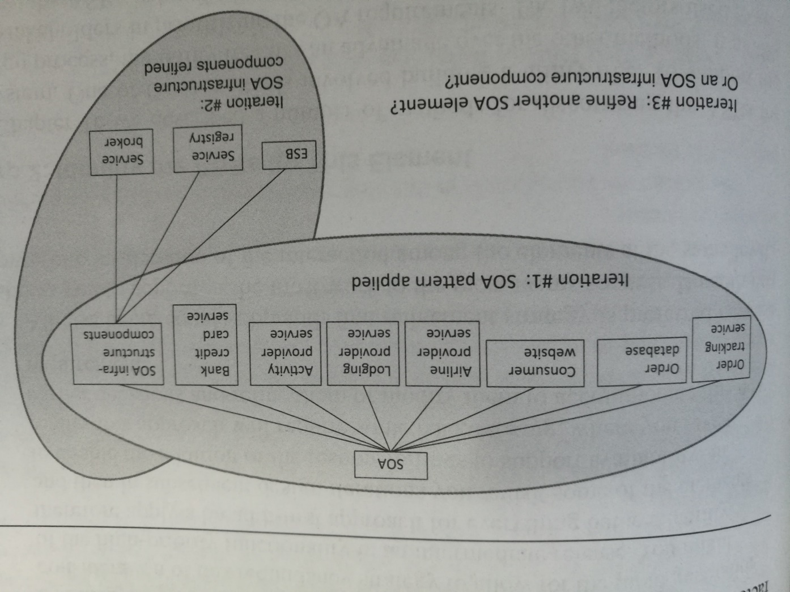

Slide 22
Step 1 example
We want to design a system for online travel agency

Slide 23
Step 1 example
In iteration #1, we decide to apply SOA pattern (Service Oriented Architecture, where functions of the system will become services)
We decompose our system into necessary components based on SOA pattern

Slide 24
Step 1 example
Then, we need to choose which part of the system to design next,
In iteration #2, we choose to further design SOA infrastructure components element
We decide to decompose it into 3 components

Slide 25
Step 1 example
Then, we need to choose which part of the system to design next,
In iteration #3, which element should we choose to design?
Refine one of the remaining SOA elements?
Refine one of the SOA infrastructure components?

Slide 26
Which Element Comes Next?
Two basic refinement strategies:
Breadth first
Depth first
Which one to choose?
If using new technology => depth first: explore the implications of using that technology.
If a team needs work => depth first: generate requirements for that team.
Otherwise => breadth first.

Slide 27
Step 2: Identify the ASRs for the Chosen Element
If the chosen element is the whole system, then use a utility tree (as described earlier).
If the chosen element is further down the decomposition tree, then generate a utility tree from the requirements for that element.

Slide 28
Step 3: Generate a Design Solution for the Chosen Element
Apply generate and test to the chosen element with its ASRs
Generate Initial Hypothesis
Test hypothesis
Generate Next Hypothesis

Slide 29
Step 4
Inventory remaining requirements and select the input for the next iteration
We need to consider 3 kinds of requirements
Functional requirements
Quality attribute requirements
Constraints

Slide 30
Step 4: Select the Input for the Next Iteration
For each functional requirement
Ensure that requirement has been satisfied.
If not, then add responsibilities to satisfy the requirement.
Add them to container with similar requirements
If no such container, may need to create new one or add to container with dissimilar responsibilities (coherence)
If container has too many requirements for a team, split it into two portions. Try to achieve loose coupling when splitting.

Slide 31
Quality Attribute Requirements
If the quality attribute requirement has been satisfied, it does not need to be further considered.
If the quality attribute requirement has not been satisfied then either
Delegate it to one of the child elements
Split it among the child elements
If the quality attribute cannot be satisfied, see if it can be weakened. If it cannot be satisfied or weakened then it cannot be met.

Slide 32
Constraints
Constraints are treated as quality attribute requirements have been treated.
Satisfied
Delegated
Split
Unsatisfiable

Slide 33
Repeat Steps 1–4 Until All ASRs are Satisfied
At end of step 4, each child element will have associated with it a set of:
functional requirements,
quality attribute requirements, and
constraints.
This sets up the child element for the next iteration of the method.

Slide 34
Summary
Architectures are driven by Architecturally Significant Requirements (ASRs):
requirements that will have profound effects on the architecture.
ASRs may be captured
from requirements documents,
by interviewing stakeholders, or
by conducting a Quality Attribute Workshop.

Slide 35
Summary
A useful representation of quality attribute requirements is in a utility tree.
The utility tree helps to capture these requirements in a structured form.
Scenarios are prioritized.
This prioritized set defines your “marching orders” as an architect.

Slide 36
Summary
Designing Strategies
Decomposition
Designing to Architecturally Significant Requirements
Generate and Test

